Slide 1
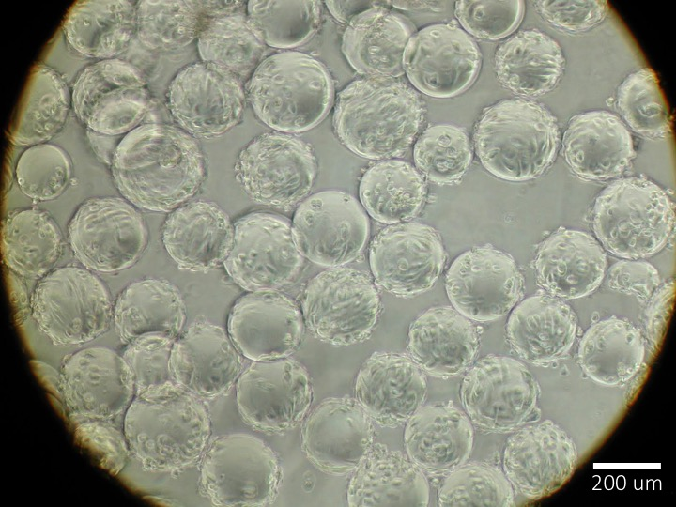
Demographic Inclusiveness in Human Cell Studies

Slide 2
Motivation
The discovery of new medical therapies begins with human cell models, progresses to animal models, and finally human test subjects. During the initial cell model stage, researchers purchase cells from an existing archive, populated by human donors since 1951. The demographic representation in the cell archive available to researchers may bias the generalizability of the research findings. The proposed work to characterize demographic bias in cell models aligns with current efforts within the pharmaceutical industry for personalized medicine based on an individual genetic make-up. The broader impact of the proposed research is in its potential to enhance knowledge of inefficiencies within the drug discovery process.

Slide 3
Objective
The objective is to assess demographic inclusiveness during the cell model phase of medical research by characterizing the assets available to researchers, how researchers use those assets and the existing gaps in treatment efficacy.

Slide 4
Research Tasks
How are demographics represented in the tools available to medical researchers?
Characterize available cell lines
How do researcher use these tools?
Characterize frequency of each cell lines cited in publications.
How do such tools impact therapeutic options?
Characterize the frequency of cell lines cited in patent applications.
Does the efficacy of treatment decrease for demographics not represented in the tools available to medical researchers?
Compare a timeline on CDC statistics for disease morbidity to occurrences of cell lines cited in publications and patents.

Slide 5
Results
Characterize the demographics of the cell lines available to researchers.
Characterize how researchers use the available cell lines in published research.
Compare demographic representation of cell lines in publications to morbidity rates (CDC data).

Slide 6
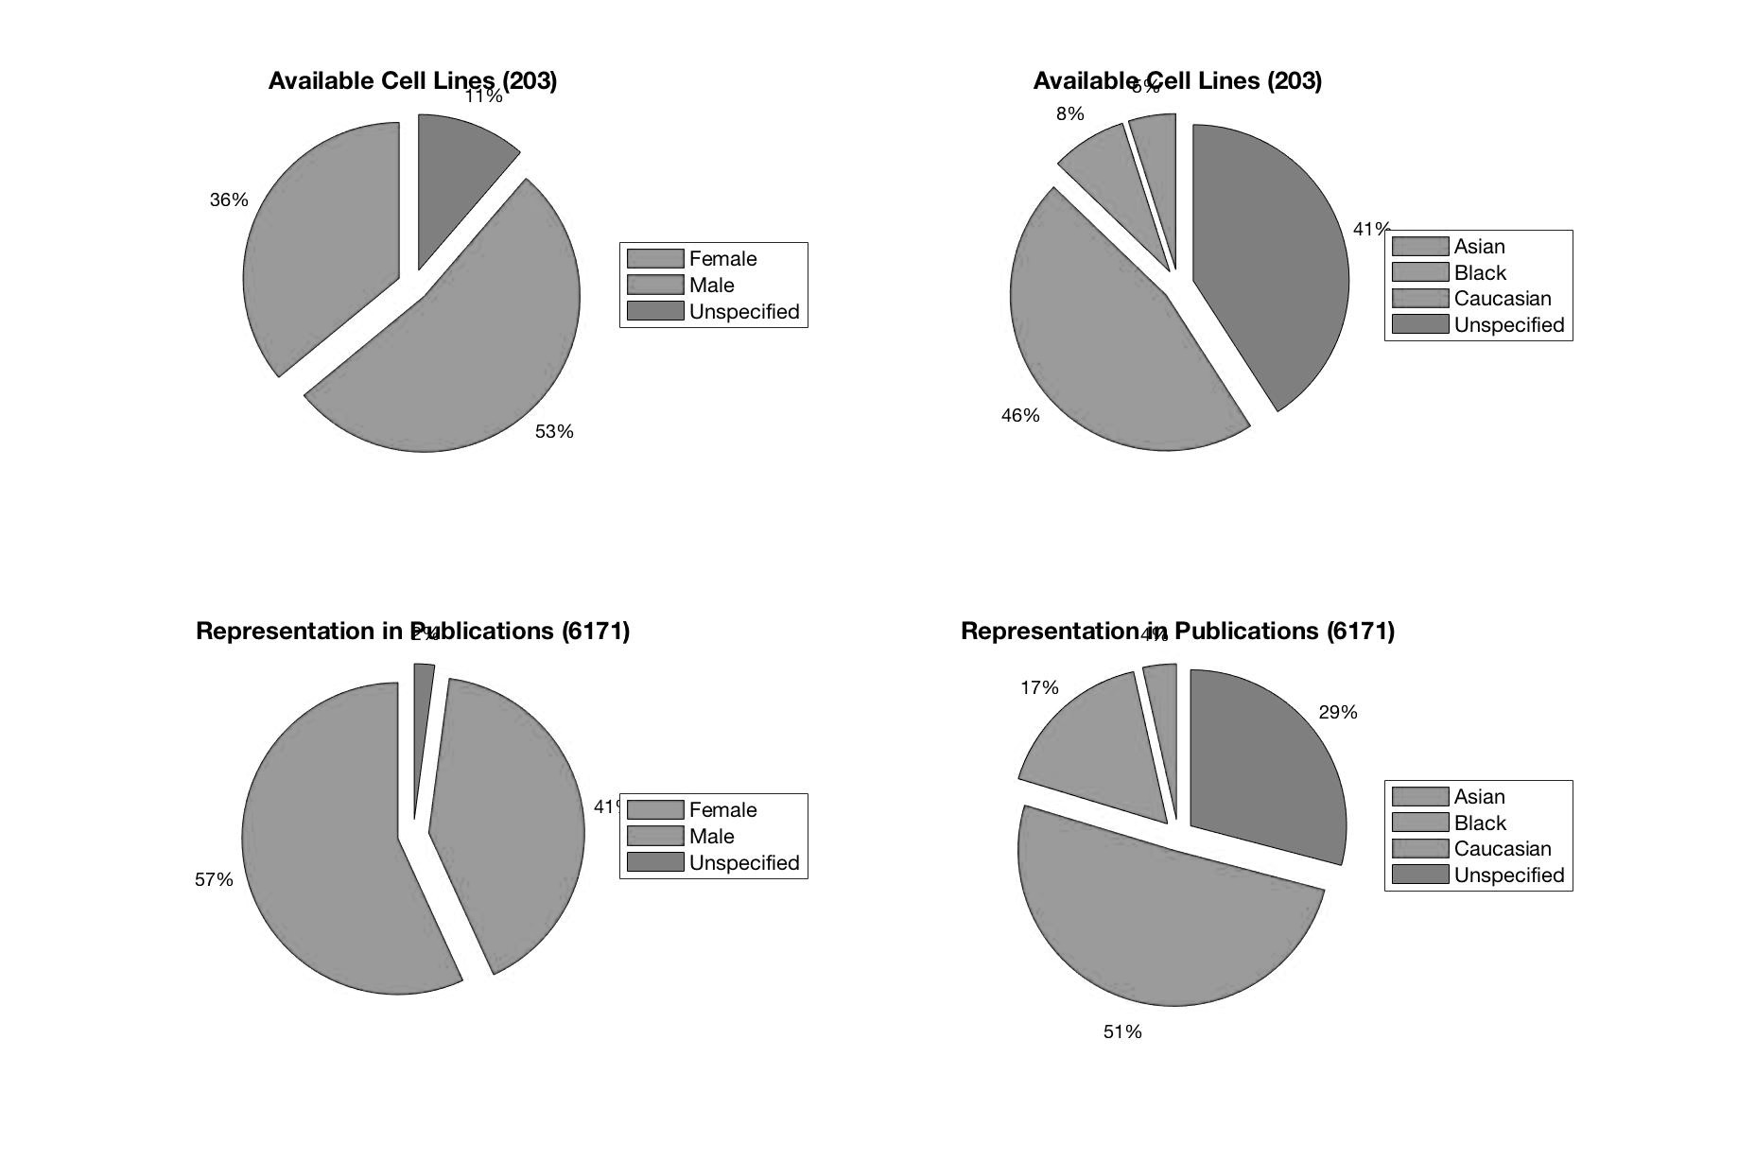
What cell lines are available?

Slide 7
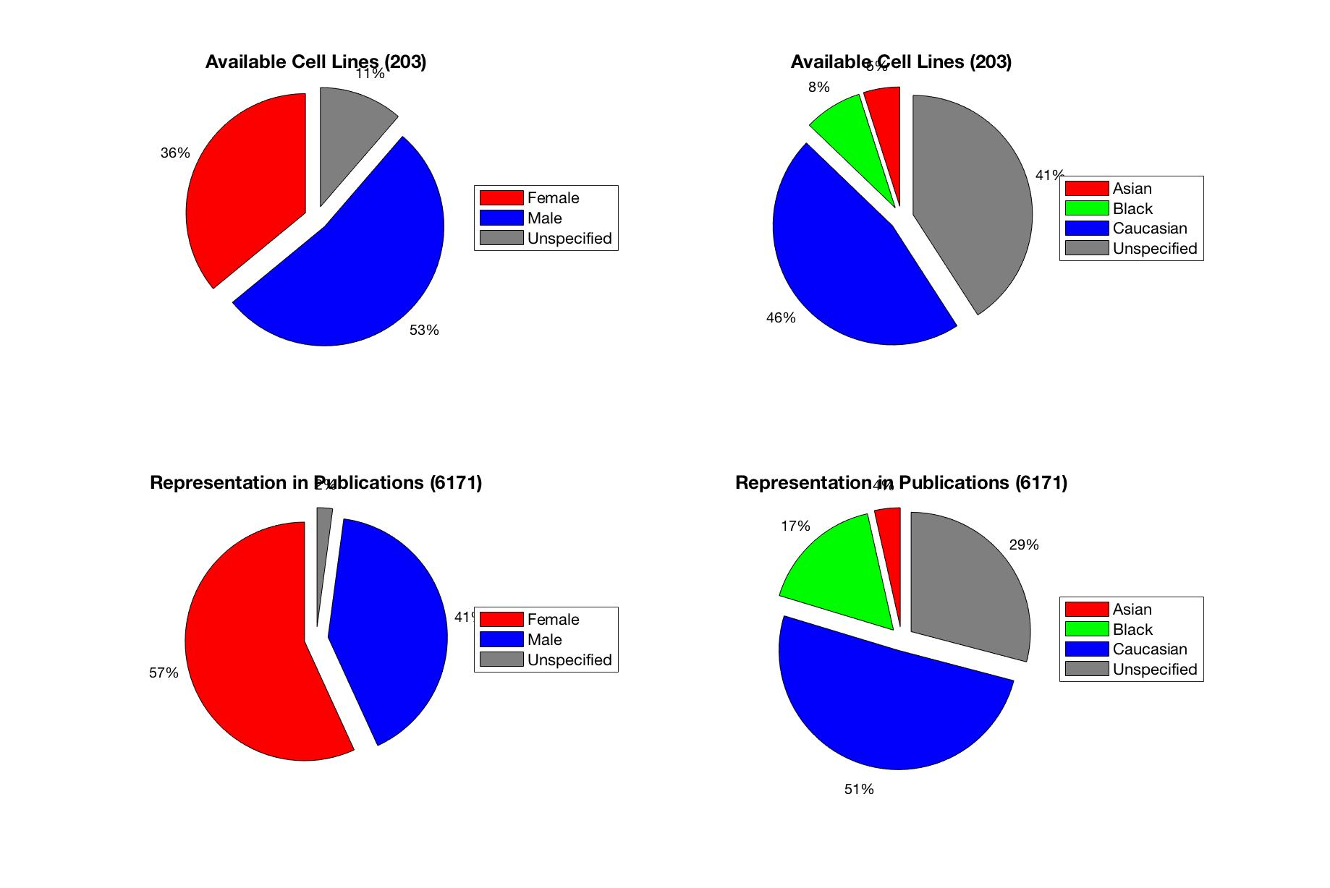
Demographics defined from cell line specification sheets.

Slide 8
Representation in publications from mentions of cell lines.

Slide 9
The original cell line was donated by a Black female.
This may explain the representation in publications.

Slide 10
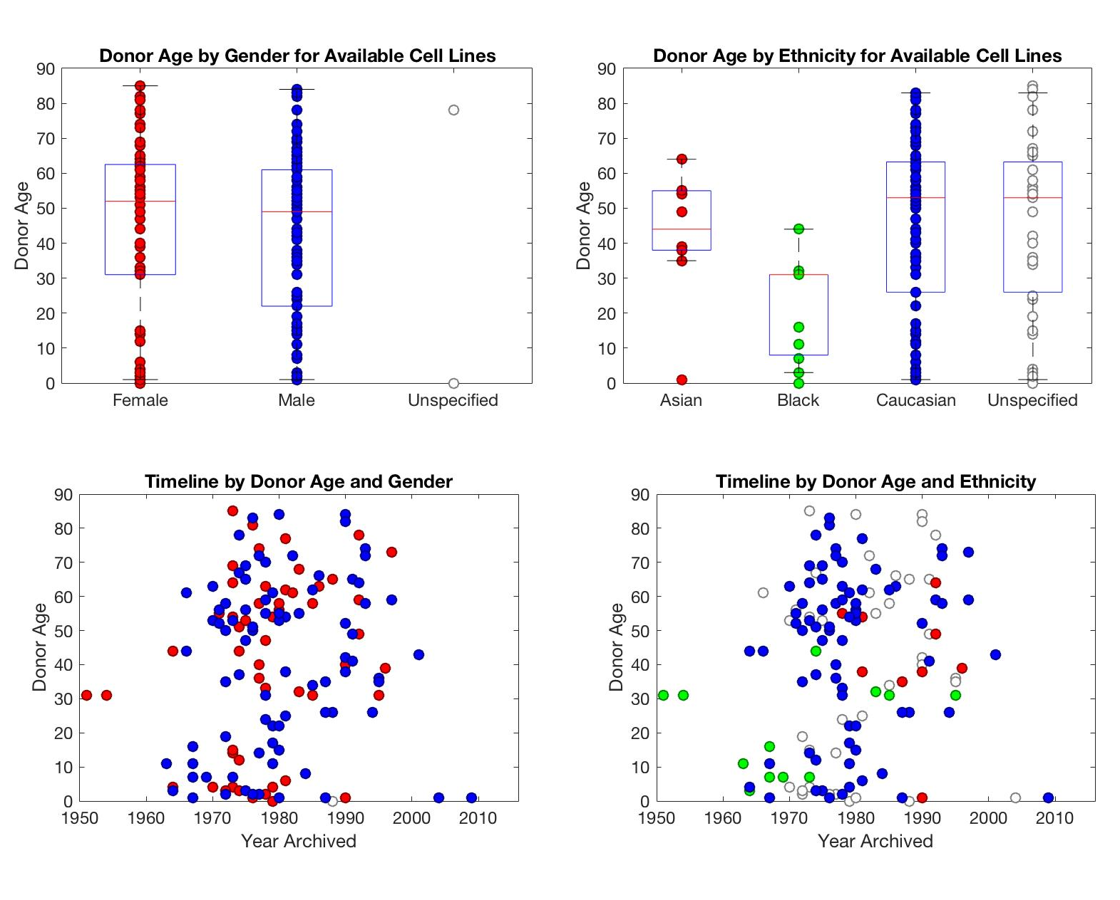
Timeline of the cell line catalog. Donor demographics by age, gender and ethnicity

Slide 11
Asian donors younger than 30 are not represented, neither are Black donors older than 40.
The more numerous Caucasian donors best represent the expected life span.

Slide 12
The first cell line was donated by a Black female.

Slide 13
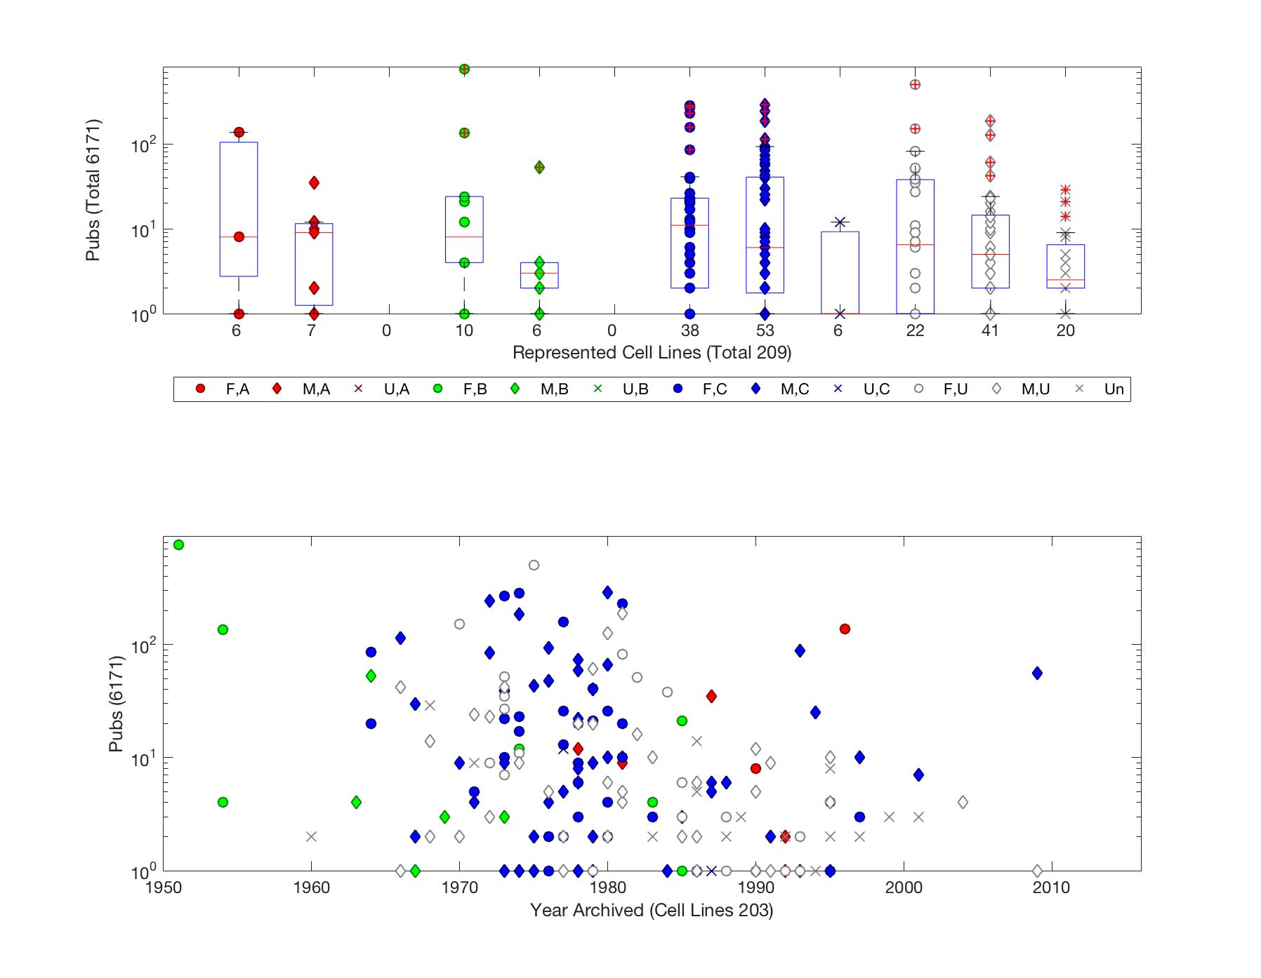
Demographic representation of the available cell lines in publications.

Slide 14
Caucasian is the best represented ethnicity among the available cell lines.

Slide 15
The most frequently cited is also the first established cell line.

Slide 16
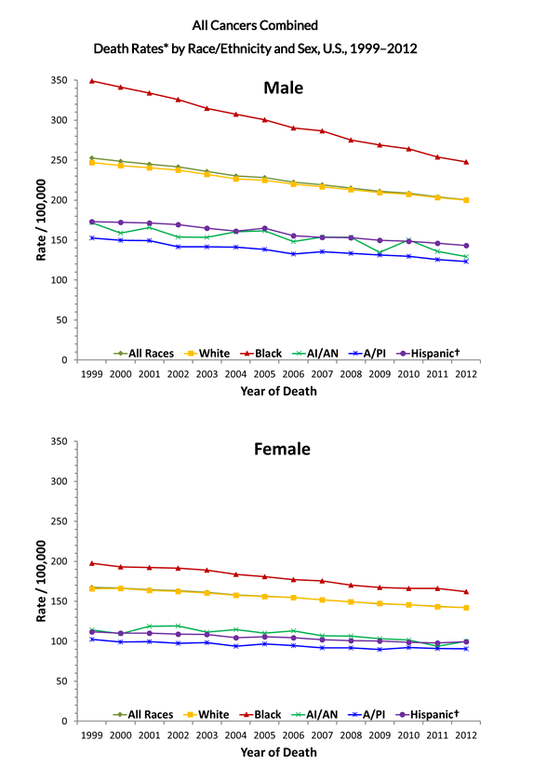
CDC statistics on demographics of cancer morbidity
http://www.cdc.gov/cancer/dcpc/data/race.htm

Slide 17
Cell line use in publications by disease

Slide 18
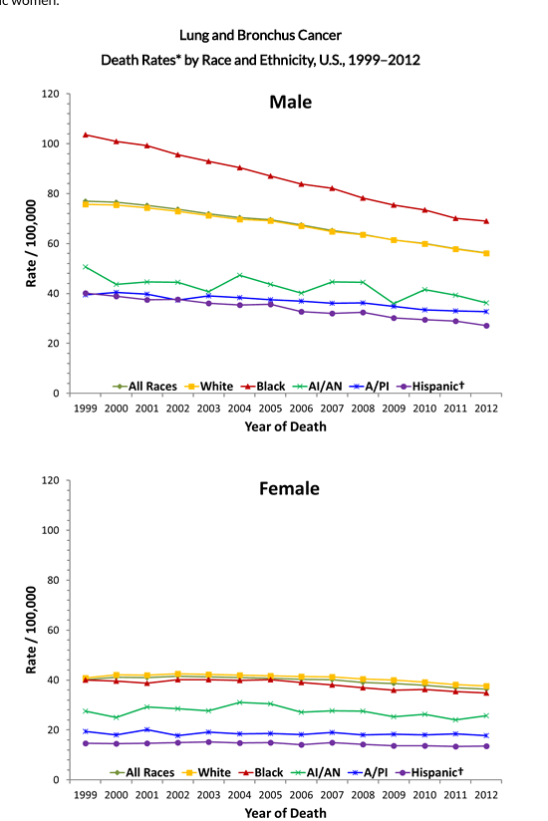
CDC statistics on demographics of lung cancer morbidity
http://www.cdc.gov/cancer/lung/statistics/race.htm

Slide 19
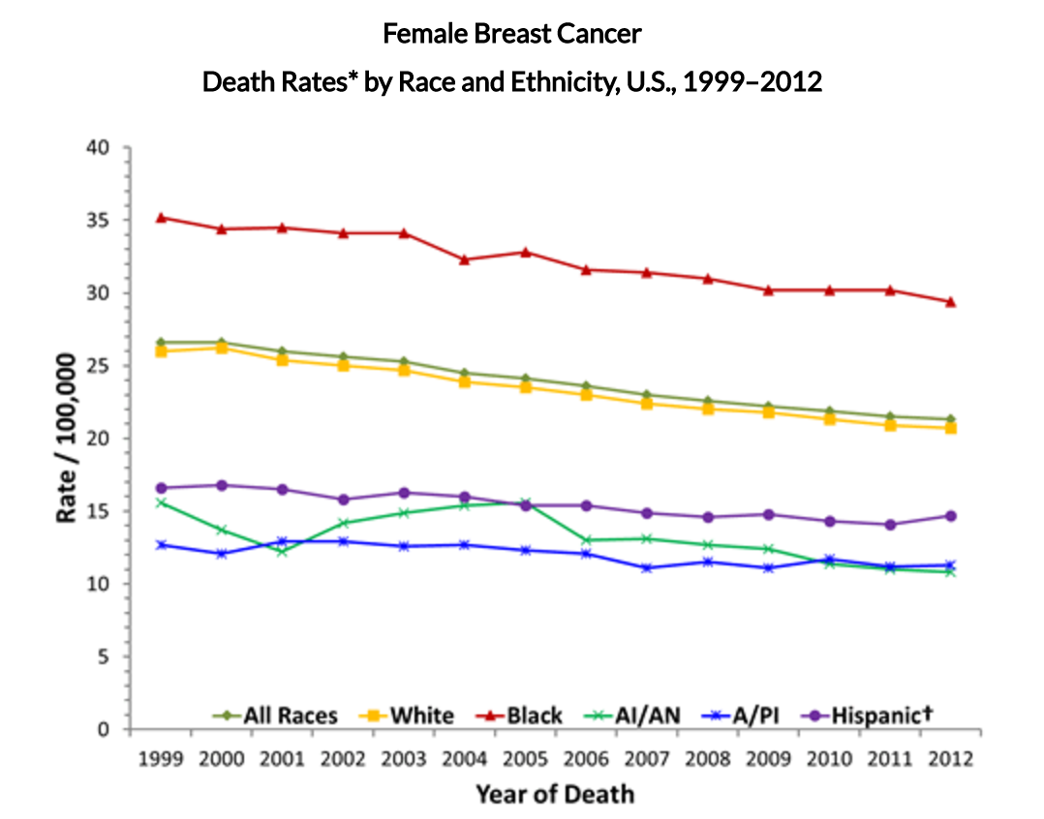
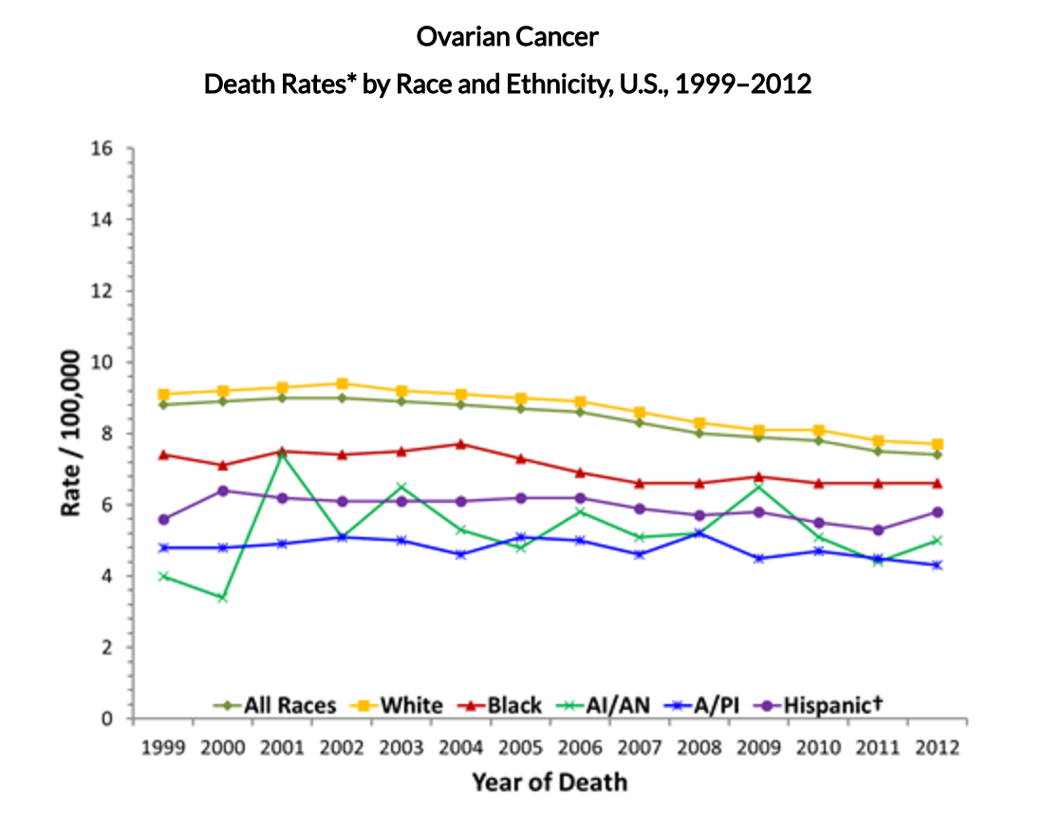
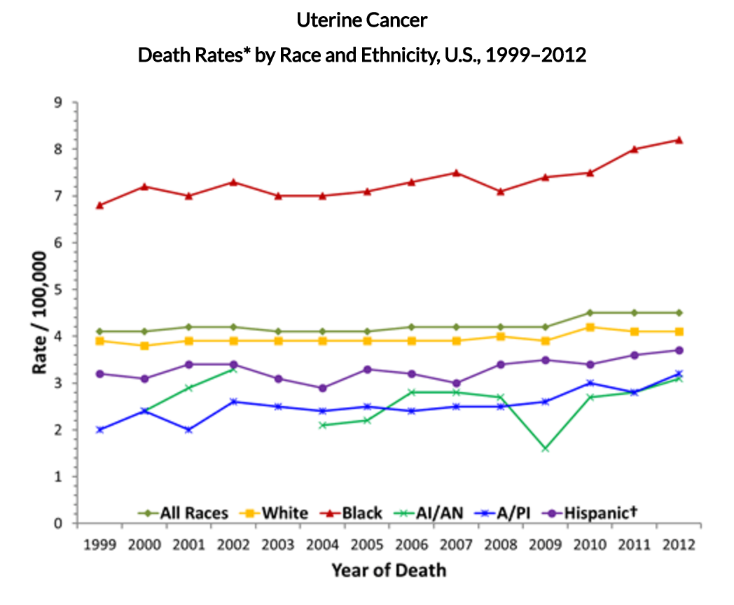
CDC statistics on demographics of breast, uterine and ovarian cancer morbidity
http://www.cdc.gov/cancer/breast/statistics/race.htm . http://www.cdc.gov/cancer/uterine/statistics/race.htm . http://www.cdc.gov/cancer/ovarian/statistics/race.htm

Slide 20
Discussion
How are demographics represented in the tools available to medical researchers?
Characterize available cell lines
How do researcher use these tools?
Characterize frequency of each cell lines cited in publications.
How do such tools impact therapeutic options?
Characterize the frequency of cell lines cited in patent applications.
Does the efficacy of treatment decrease for demographics not represented in the tools available to medical researchers?
Compare a timeline on CDC statistics for disease morbidity to occurrences of cell lines cited in publications and patents.

Slide 21
Conclusion
This retrospective characterizes the existing tool kit for medical researchers to study human cells in vitro, exposing gaps in the demographic representation of the existing tools, comparing those gaps with deficiencies in treatment efficacy.

